Slide 1
Sales Analysis Dashboard
DS-620 –Data Visualization
Premchand M
Kasthur Reddy Padarthi

Slide 2
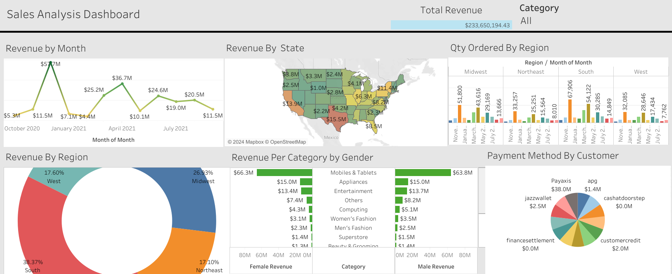

Slide 3
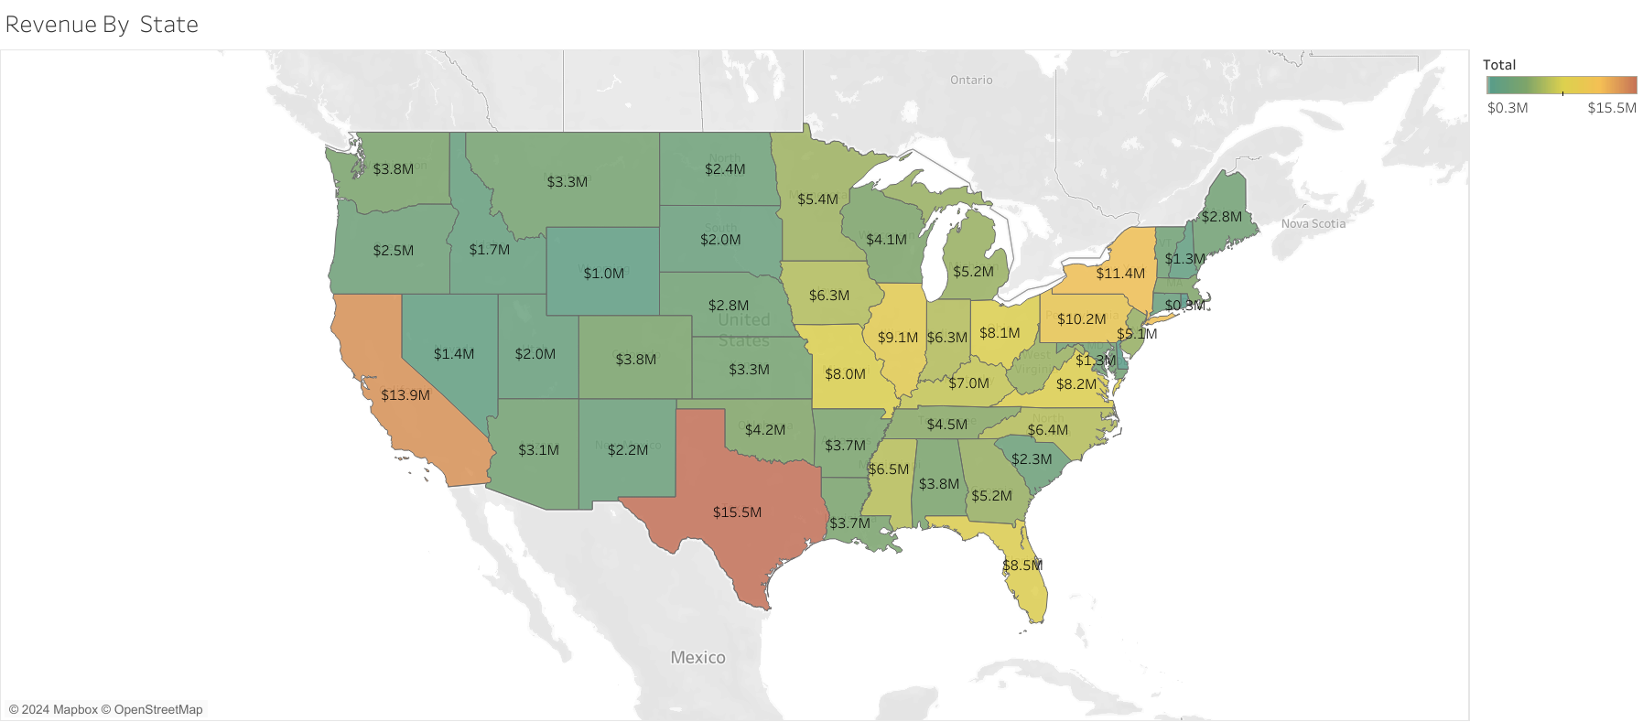
Here The Graph shows Revenue generated By state.
We can see Texas being the highest revenue generator whereas WY has the lowest revenue

Slide 4
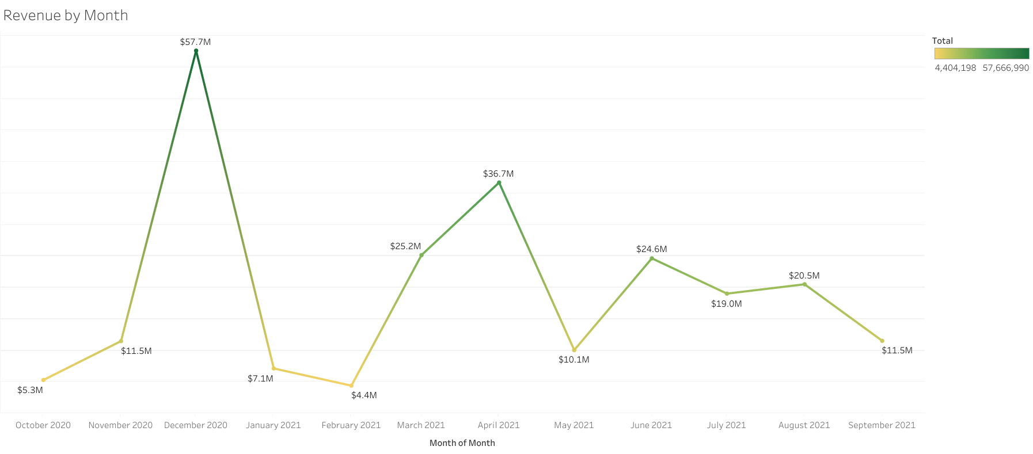
We can see the drastic increase in revenue in the month of December the any other month in the year

Slide 5
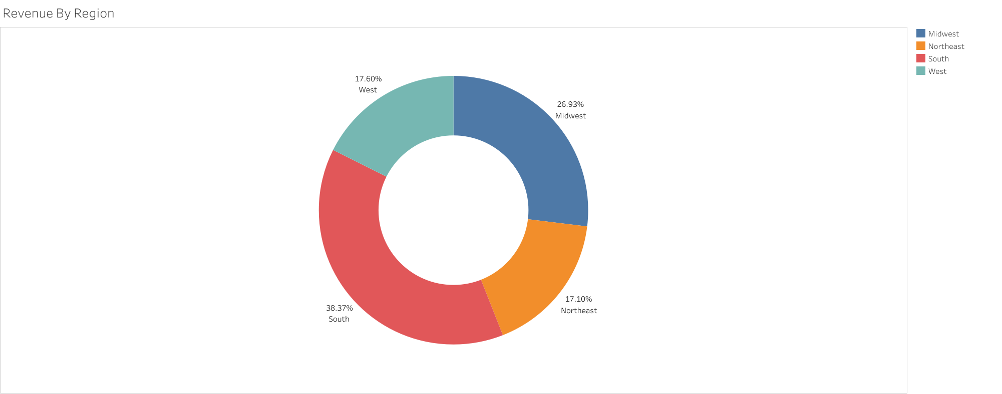
We See Region South has 38.37% of total revenue states such as Texas where Northeast being the Lowest with 17.10%

Slide 6
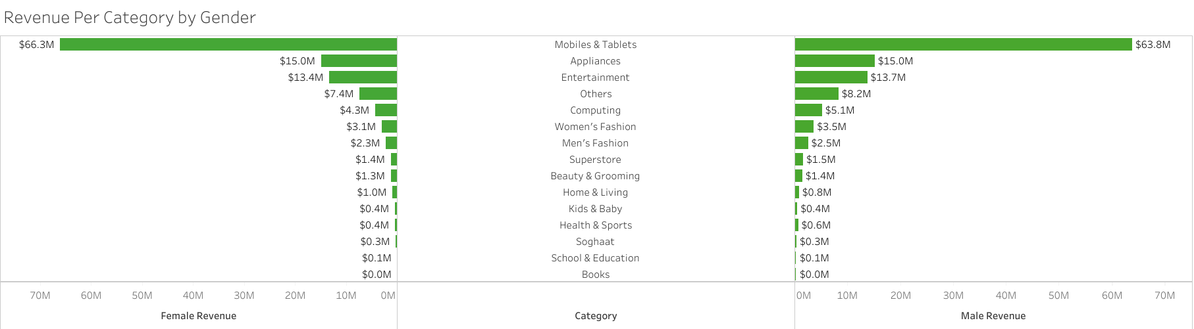

Slide 7
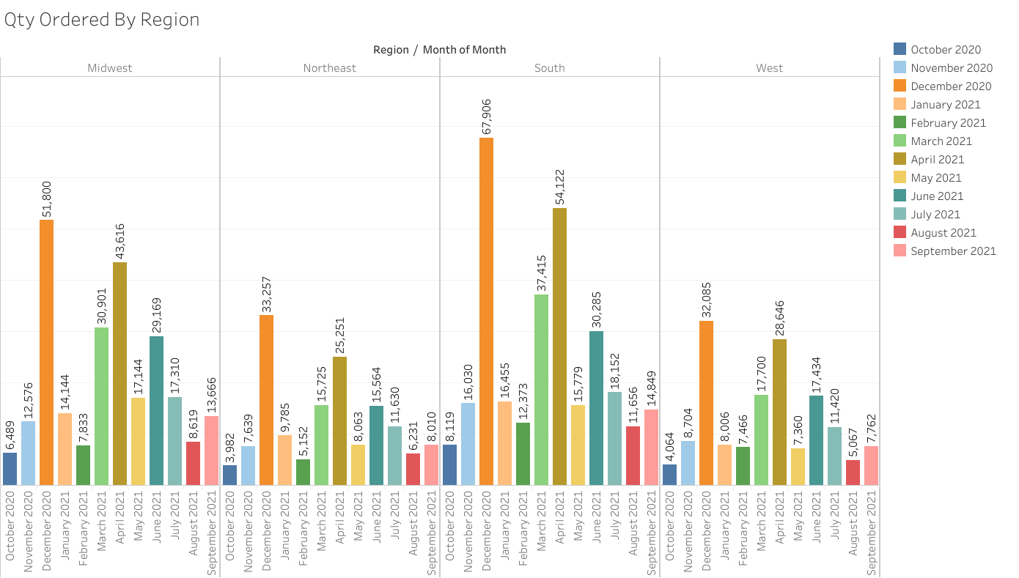
We can analyze in the month of December has highest qty ordered throughout all regions

Slide 8
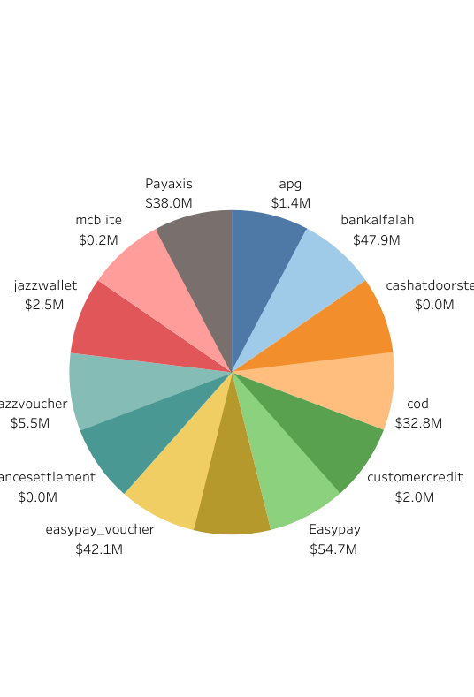
Easy pay is most sought payment method among the customers.

